Slide 1

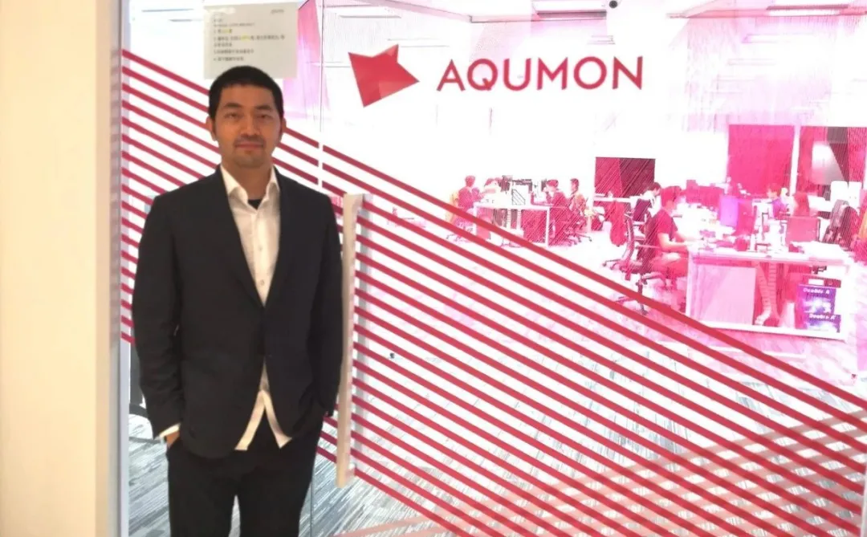

AQUMON Background
In 2016, AQUMON incubated from the Hong Kong University of Science and Technology, become a leading startup company in the financial technology industry in Asia.
AQUMON is committed to providing transparent, stable, and low-cost financial services to more institutions and retail customers through the combination of finance, algorithms and technology.
AQUMON holds the Hong Kong Securities Regulatory Commission No. 1 (securities trading), No. 4 (advising on securities), No. 9 (asset management) licenses and the U.S. Securities Regulatory Commission Registered Investment Adviser (RIA) license.

Slide 2


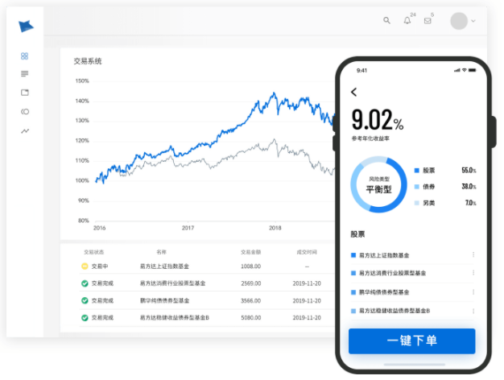
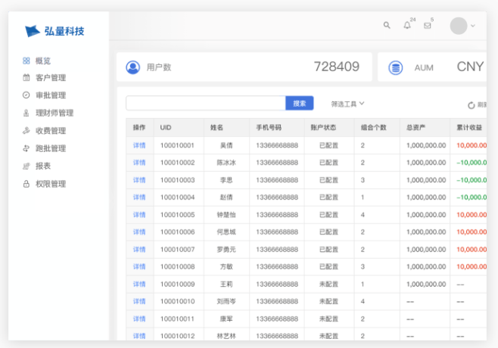

The founder's story
On May 1, 2008, two months before the financial crisis, Kelvin landed in Hong Kong and began his career in investment banking derivatives sales. In July, Kelvin made a large order of 2 billion Hong Kong dollars with a major state-owned company. But a month later there was a financial crisis.
When he first entered the industry, he experienced the highest peak of the industry, and then hit the top and fell, and his Season 2 began.
Start a business! In the robo-advisory field
To perform well, you need……
a strong engineering framework,
constantly iterative and updated algorithms;
a strong R&D team, preferably half of them are PhDs
a lot of experience accumulation and firm performance;
more flexible and more engineering than the predecessors.

Slide 3




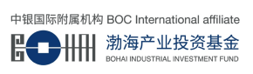



AQUMON’s funding history
2020-05-07
Pre B round
thirty million dollars
Zheng He Capital, Lenovo Ventures, Alibaba, Wing Lung Bank family,
Hong Kong government's Cyberport, etc.
2018-09-10
A++ round
2018-09-06
Alibaba
A+ round
L.P. Fund
2017-06-22
BOCI Investment
A round
Alibaba
Angel
round
Alibaba Hong Kong
Entrepreneurs Fund

